Slide 1
continuous integration and continuous deployment with GitHub basics
Krishna Bhargavi Pabbaraju
W0866008
T850-005

Slide 2
AGENDA
Introduction to CI/CD
Why CI/CD
Workflow
Use case
Best practices
Q&A session
Actions and Workflow Limits

Slide 3
Introduction to CI/CD
Continuous integration (CI): Automatically builds, tests, and integrates code changes within a shared repository
Continuous delivery (CD): automatically delivers code changes to production-ready environments for approval
Continuous deployment (CD): automatically deploys code changes to customers directly

Slide 4
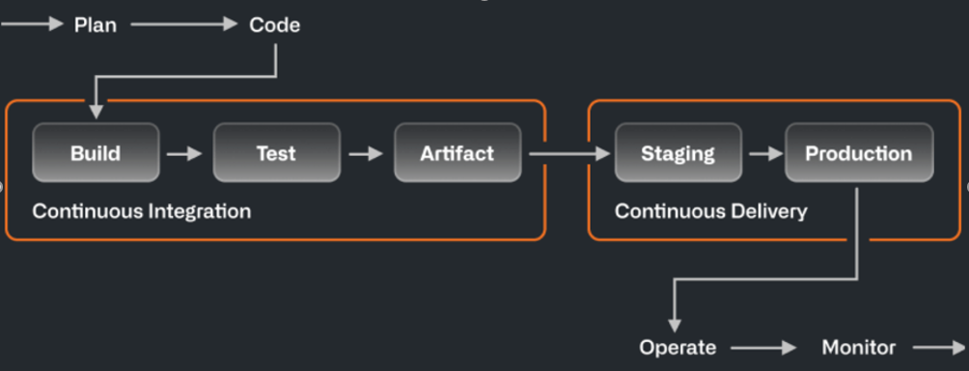
Introduction to CI/CD
Source: https://github.com/resources/articles/devops/ci-cd

Slide 5
Why CI/CD?
Development velocity
Stability and reliability
Business growth

Slide 6
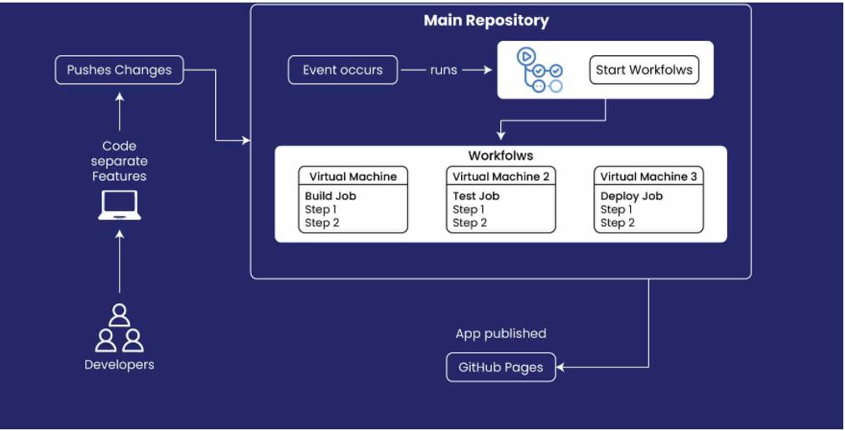
Workflow
Source: https://www.vlinkinfo.com/blog/how-to-build-a-cicd-pipeline/

Slide 7
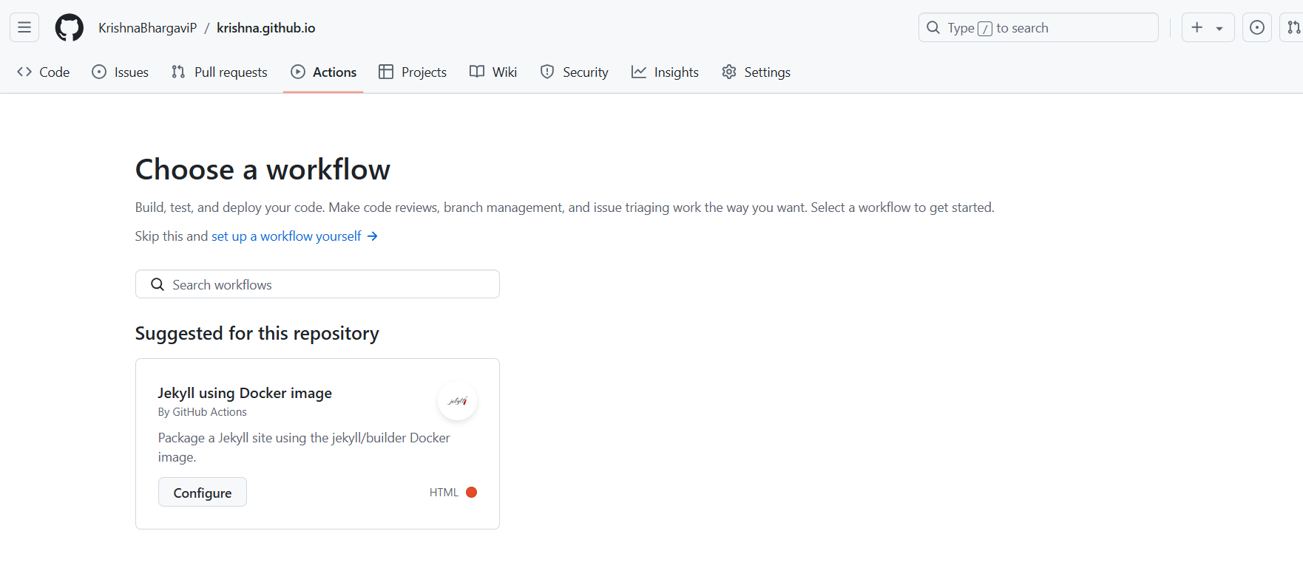
Example – my portfolio project

Slide 8
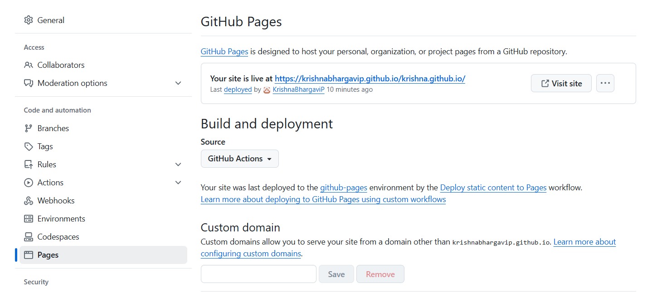

Slide 9
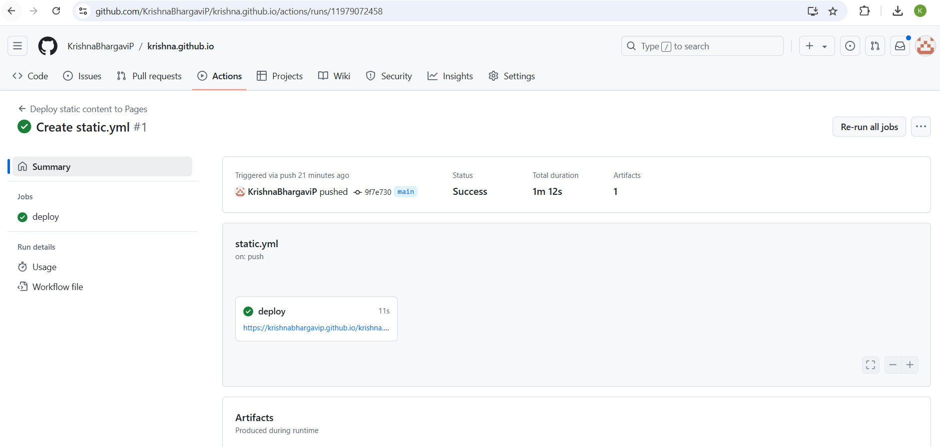

Slide 10
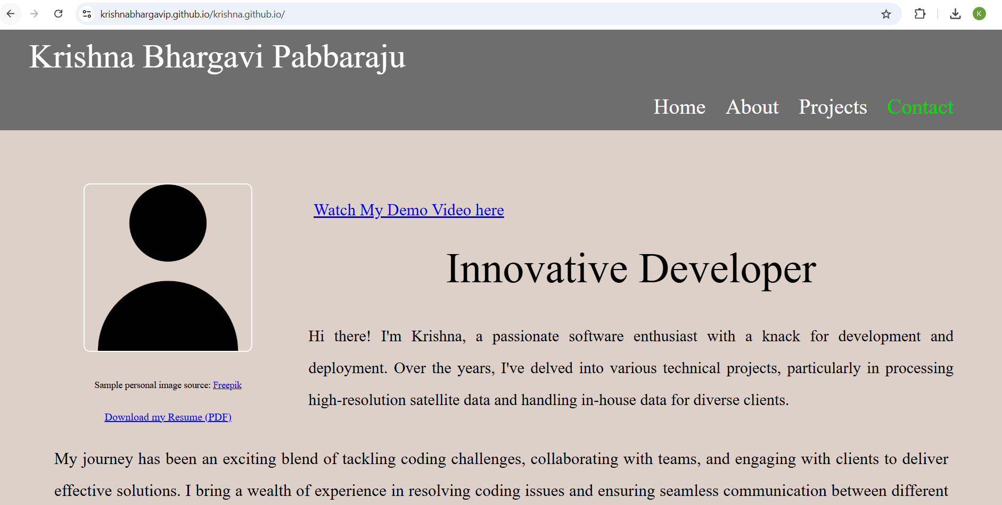
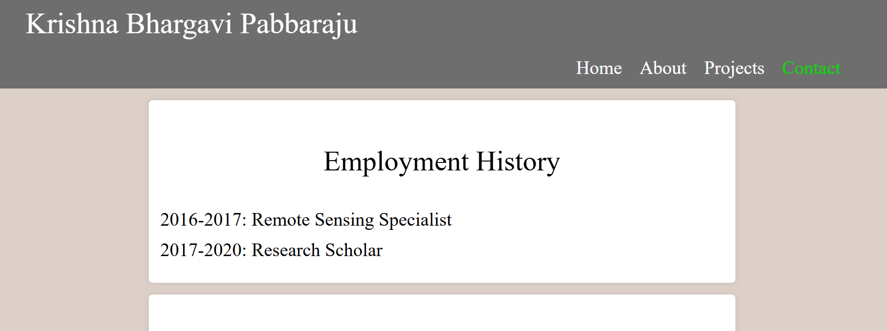
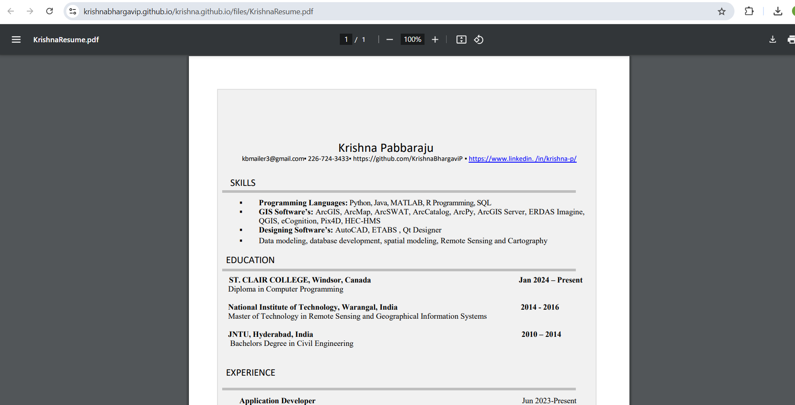
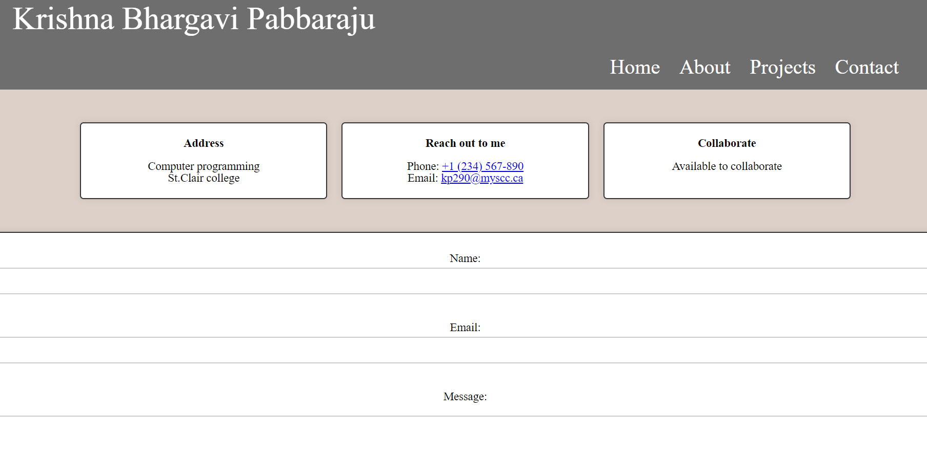
RESULT
https://krishnabhargavip.github.io/krishna.github.io/

Slide 11
Best practices
Use separate branches for development and deployment
Automate build and deployments with GitHub Actions
Keep Your GitHub Pages Deployment Secure
Run Tests Before Deploying
Version Control for Content and Design
Monitor and Log Deployments

Slide 12
Actions and Workflow Limits
For GitHub Actions (used in CI/CD workflows), the free tier allows up to 2,000 minutes of usage per month for public repositories and 500 minutes for private repositories.
Storage for artifacts and logs is limited, with 500 MB allocated for free accounts.

Slide 13
Any Questions ?
Thank you

